Slide 1
Analysis of 17K smartphone games
Jeff Bertucci

Slide 2

About the Data
Pulled from Kaggle https://www.kaggle.com/tristan581/17k-apple-app-store-strategy-games
17K rows, containing structured and unstructured data (18 columns total)
Structured: ratings, number of ratings, prices, app size
Unstructured: App names, descriptions, in app purchases

Slide 3

Data Questions to answer
What are hot button terms that will cause apps to be sold/downloaded in either the app name or the app description?
What games tend to do well in the oversaturated market?
What is the customer impact of high to low reviewed games?
Does app size factor in to number of reviews/overall rating?

Slide 4
Cleaning the data/data preparation
In excel, extraneous data columns are removed, leaving 6 total columns
App Name, App description, app price, overall rating, number of reviews, size
In Python, after data load, each line is pulled into a list which is then converted to a pandas dataframe for additional summarization
Numerical data is coerced into numerical formatting
Descriptions and titles are separated and tokenized for additional analysis

Slide 5
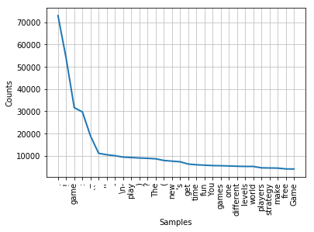
Description analysis
Top frequency words in app descriptions:

Slide 6
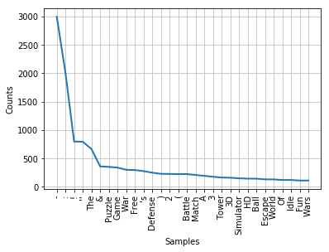
Title analysis
Top frequency words used in app titles:

Slide 7
Top 10 Games by Rating/number of ratings
Name | Rating | Sales | Size
Cash Inc. Fame & Fortune Game | 5 | 374772 | 245957632
Egg Inc. | 5 | 174591 | 74891264
AFK Arena | 5 | 156766 | 225711104
South Park: Phone Destroyer\u2122 | 5 | 156044 | 130186240
From Zero to Hero: Cityman | 5 | 146729 | 296638464
Sushi Bar Idle | 5 | 123606 | 257325056
Fire Emblem Heroes | 5 | 120283 | 175634432
Bloons TD 5 | 5 | 97776 | 133326848
Naval Warfare | 5 | 90214 | 43198464
Idle Roller Coaster | 5 | 88855 | 234342400

Slide 8
Structured data analysis-Sales/ratings
In the 4 to 5 star range:
Bloons TD 5
Total dollars earned from sale of app: $292,350.24
In the 3 to 4 star range:
Traffic Rush
Total dollars earned from sale of app: $210,635.37
In the 2 to 3 star range:
Omar Sharif Bridge
Total dollars earned from sale of app: $2,150.41
In the 1 to 2 star range:
Waste Land : savage survival of fear world games
Total dollars earned from sale of app: $95.68
App sales: a term described by number of app reviews multiplied by the price of the app
This leaves out any apps that are free
Shows an exponential decrease in sales as number of stars decreases
Note: this rounds stars up to the next star rating

Slide 9
Structured Data analysis-Size
Average game size: 115,707,530 bytes
8 of the 10 top games are larger sized than the average size of games
5 of these 8 have nearly double the average

Slide 10
Conclusions
While many of the Appstore games use similar descriptor words, the best games tend to be ones that do not use the most common names
Instead, the best reviewed games are ones with a big brand such as South Park or Fire Emblem
Additionally, a game that can be well reviewed will gain significantly more financial traction than games that fall short of the mark.
Lastly, the games reaching the top of the charts are in many cases significantly larger in size than the average competition
Result? Each of these metrics points to refute the common myth of someone throwing an app together in their basement and making millions
Instead, high effort games with a substantial amount of production time and a large team are consistently at the top of the charts.

Slide 11

Questions?

